Slide 1
Lecture 7. Graph (4)
More
Instructor: 黄群
huangqun@pku.edu.cn
School of EECS
Peking University

Slide 2
Outline
Real-World Graphs
Page Rank
Spectral Graph Theory

Slide 3

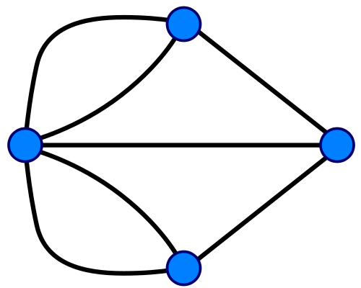
Graph Data: Technological Networks
Seven Bridges of Königsberg [Euler, 1735]
Return to the starting point by traveling each link of the graph once and only once.

Slide 4
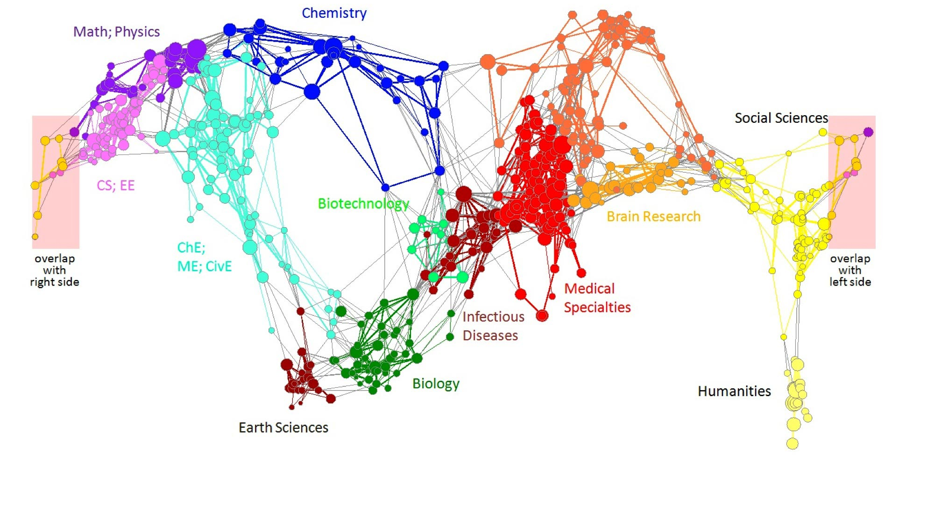
Graph Data: Information Nets
Citation networks and Maps of science
[Börner et al., 2012]

Slide 5
Graph Data: Communication Nets
domain2
domain1
router
domain3
Internet

Slide 6
Shortest Path in Computer Networks
For each packet, a router/switch needs to find a shortest path to deliver the packet to the destination
Distance Vector (DV)
based on Bellman-Ford
Since 1970~
Become great again since 2000~
OSPF
based on Dijkstra’s Algorithm
Since 1980~
domain2
domain1
router
domain3

Slide 7
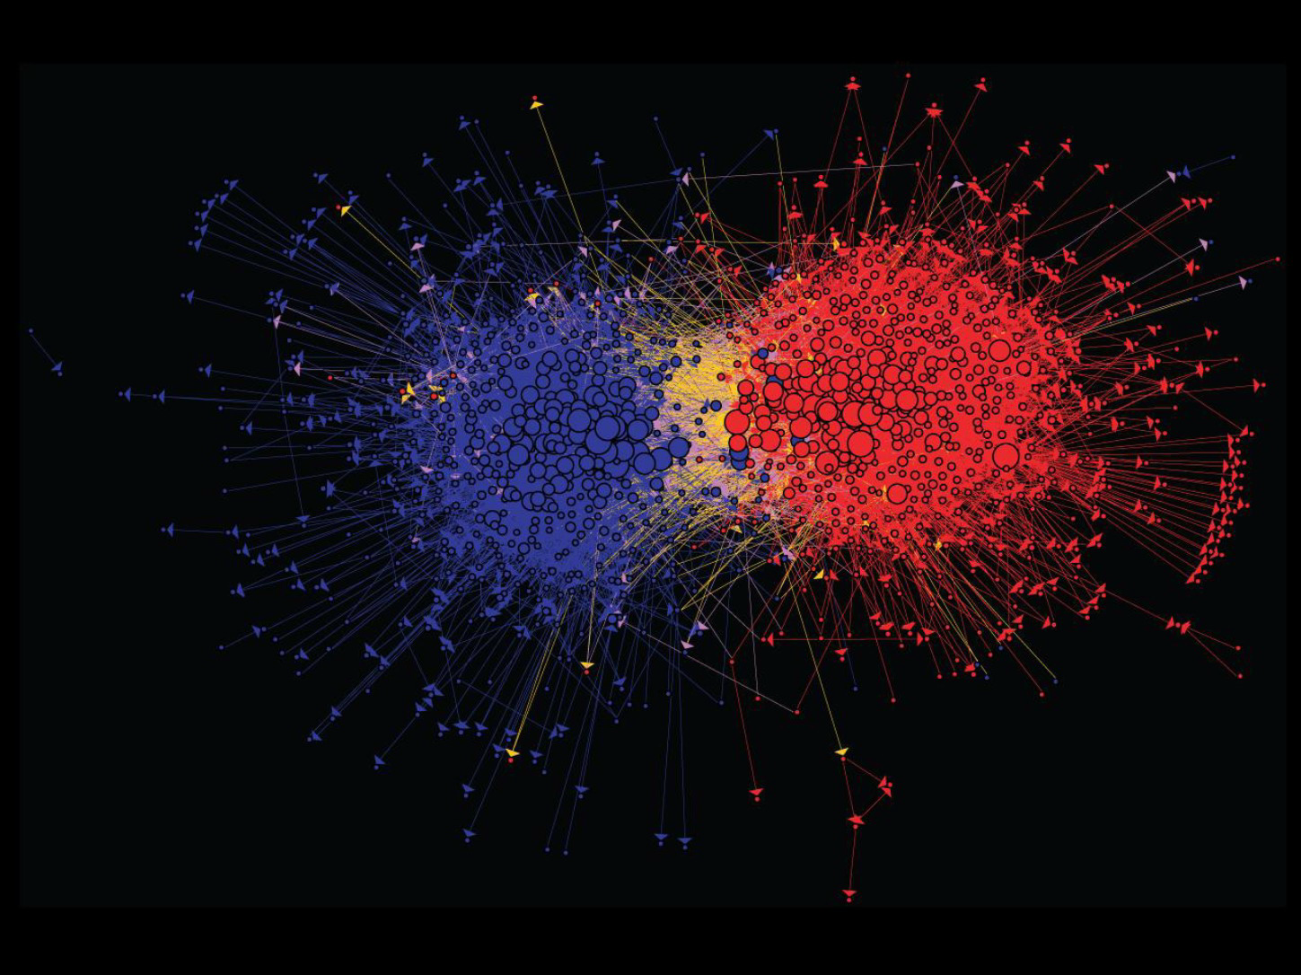
Graph Data: Media Networks
Connections between political blogs
Polarization of the network [Adamic-Glance, 2005]

Slide 8
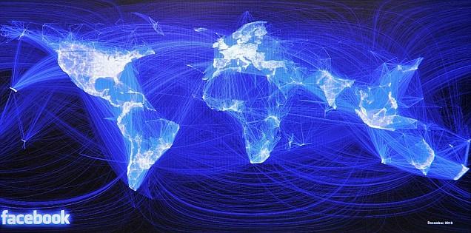
Graph Data: Social Networks
Facebook social graph
4-degrees of separation [Backstrom-Boldi-Rosa-Ugander-Vigna, 2011]

Slide 9
Small-World Networks (Graphs)
Definition:
(1) the typical distance L between two randomly chosen nodes grows proportionally to the logarithm of the number of nodes N in the network
Typical distance: average length of shortest path
(2) global clustering coefficient is not small
Examples
Social Networks
Wikipedia
Gene networks
Internet
Airport networks
Network-on-chip (NoC) hardware

Slide 10
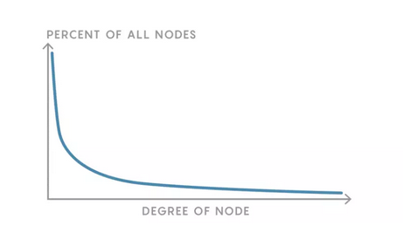
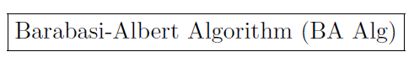
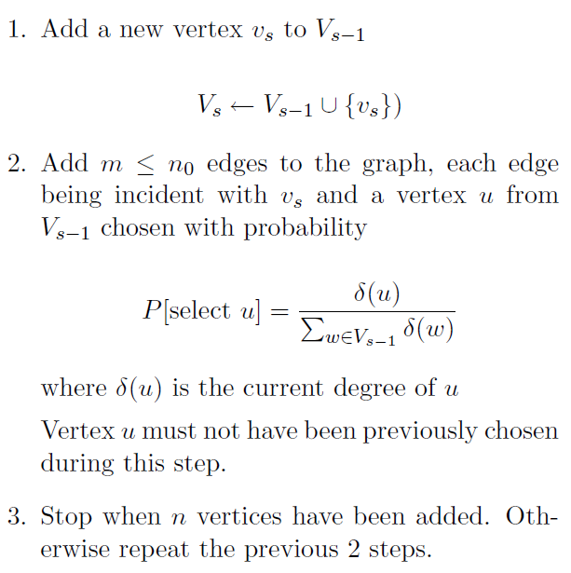
Power-Law Distribution of Node Degrees in Social Networks
Generated and Interpreted by BA Algorithm

Slide 11
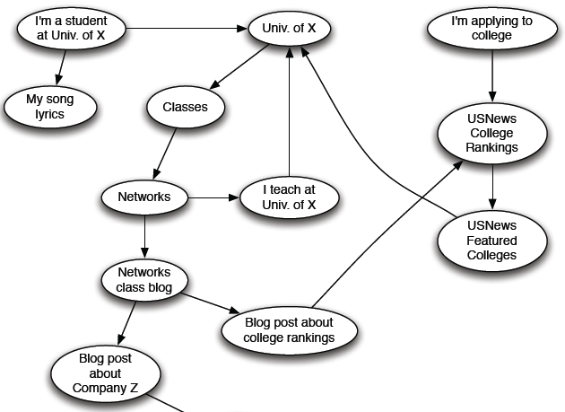
Web as Directed Graph
Web as a directed graph:
Nodes: Webpages
Edges: Hyperlinks

Slide 12

Questions
How to organize the Web?
First try: Human curated Web directories
Yahoo, DMOZ, LookSmart
Second try: Web Search
Information Retrieval investigates: Find relevant docs in a small and trusted set
Newspaper articles, Patents, etc.
But: Web is huge, full of untrusted documents, random things, web spam, etc.

Slide 13
Web Search: Challenges
2 challenges of web search:
(1) Web contains many sources of information Who to “trust”?
Trick: Trustworthy pages may point to each other!
(2) What is the “best” answer to query “blockchain”?
No single right answer
Trick: Pages that actually know about blockchains might all be pointing to many blockchain pages

Slide 14
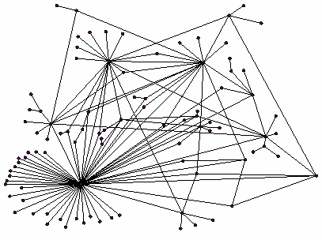
Rank Nodes in Web Graph
Let’s rank the pages by the link structure!
There is large diversity in the web-graph node connectivity

Slide 15
Outline
Real-World Graphs
Social graph
…
Web graph
Page Rank
Spectral Graph Theory

Slide 16
Page Rank: Link as Votes
Idea: Links as votes
Page is more important if it has more links
In-coming links? Out-going links?
Think of in-links as votes:
www.pku.edu.cn has 37,200 in-links
www.tsinghua.edu.cn has 444,000 in-link
Are all in-links are equal?
Links from important pages count more
Recursive question!

Slide 17


Page Rank: Link as Votes
All web pages are not equally “important”
www.pku.edu.cn has 37,200 in-links
www.tsinghua.edu.cn has 444,000 in-link

Slide 18
Example
B
38.4
C
34.3
A
3.3
D
3.9
E
8.1
F
3.9
1.6
1.6
1.6
1.6
1.6

Slide 19
Simple Recursive Formulation
Each link’s vote is proportional to the importance of its source page
If page j with importance r_{j} has n out-links, each link gets r_{j} / n votes
Page j’s own importance is the sum of the votes on its in-links
i
k
r_{i}/3
r_{k}/4
j
r_{j}/3
r_{j} = r_{i}/3+r_{k}/4
r_{j}/3
r_{j}/3

Slide 20
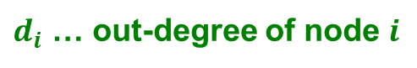
Page Rank: Flow Equations
A “vote” from an important page is worth more
A page is important if it is pointed to by other important pages
Define a “rank” r_{j} for page j
y/2
y
“Flow” equations:
r_{y} = r_{y} /2 + r_{a} /2
r_{a} = r_{y} /2 + r_{m}
r_{m} = r_{a} /2
a/2
y/2
m
a
m
a/2
$d_{i}$ … out-degree of node $i$

Slide 21
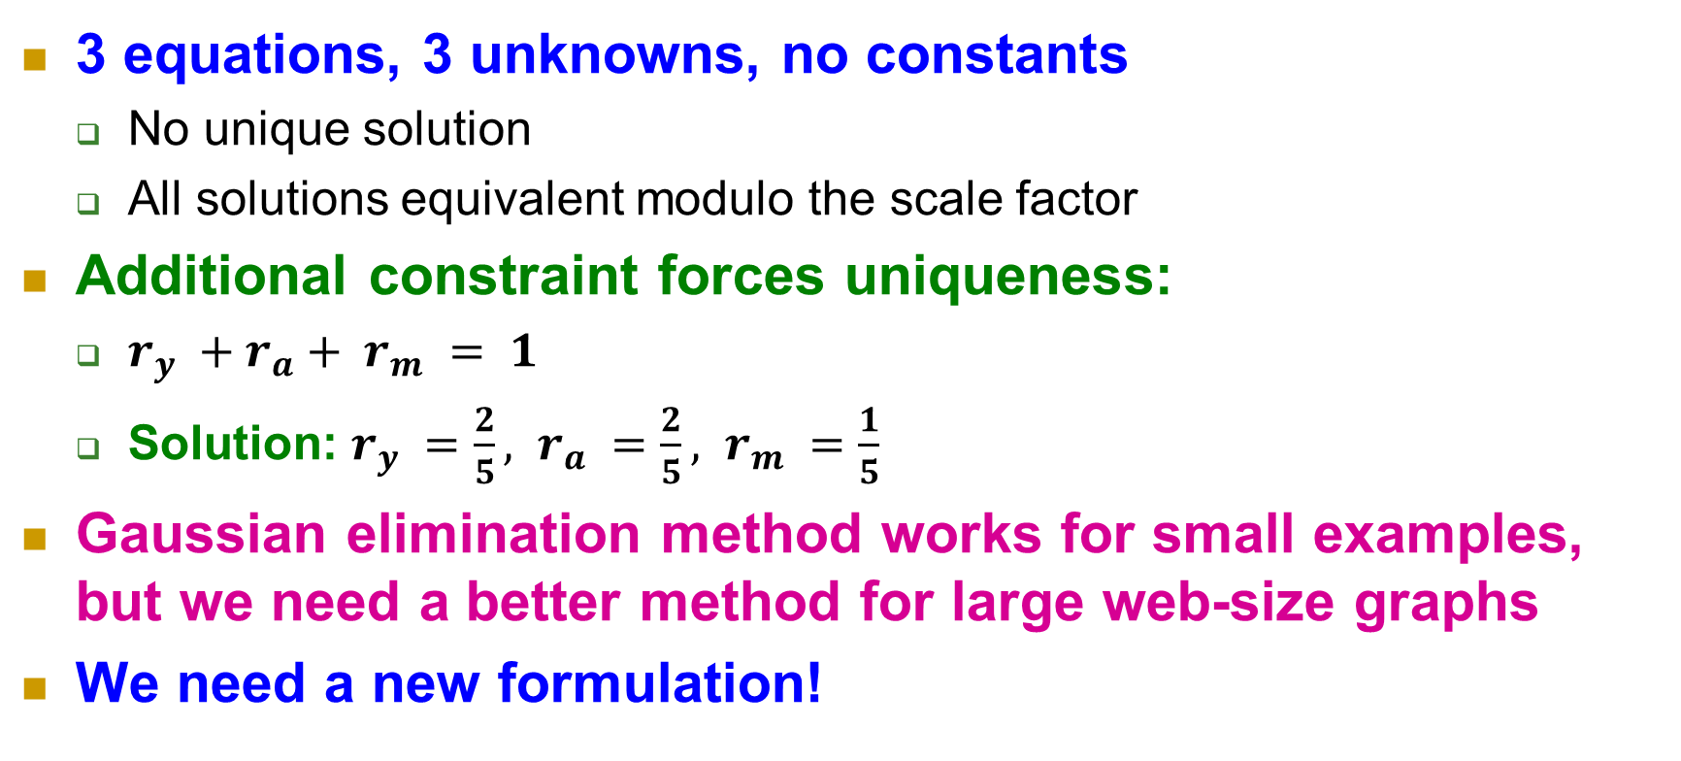
Solve The Equations
r_{y} = r_{y} /2 + r_{a} /2
r_{a} = r_{y} /2 + r_{m}
r_{m} = r_{a} /2
3 equations, 3 unknowns, no constants
No unique solution
All solutions equivalent modulo the scale factor
Additional constraint forces uniqueness:
$r_{y} +r_{a}+ r_{m} = 1$
Solution: $r_{y} =\frac{2}{5}, r_{a} =\frac{2}{5}, r_{m} =\frac{1}{5}$
Gaussian elimination method works for small examples, but we need a better method for large web-size graphs
We need a new formulation!

Slide 22
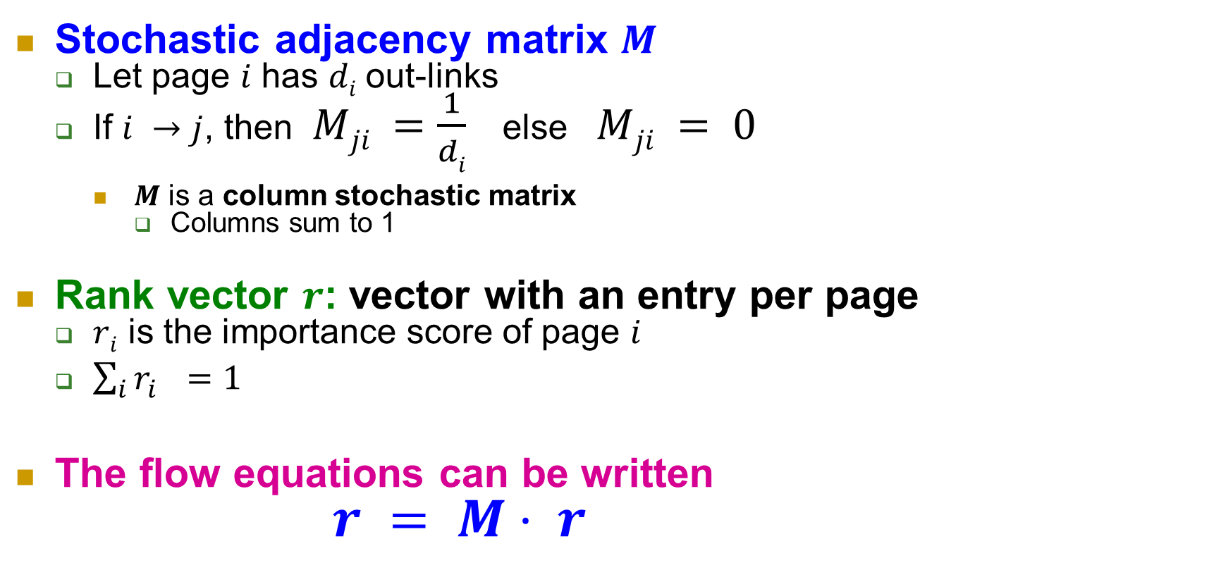
Page Rank: Matrix Formulation
Stochastic adjacency matrix $M$
Let page $i$ has $di$ out-links
If $i →j$, then $Mji =\frac{1}{di}$ else $Mji = 0$
$M$ is a column stochastic matrix
Columns sum to 1
Rank vector $r$: vector with an entry per page
$ri$ is the importance score of page $i$
$\sum_{i}{r_{i}^{}=1}$
The flow equations can be written $r = M⋅ r$

Slide 23
Example
 | y | a | m
y | ½ | ½ | 0
a | ½ | 0 | 1
m | 0 | ½ | 0
y
a
m
r = M∙r
r_{y} = r_{y} /2 + r_{a} /2
r_{a} = r_{y} /2 + r_{m}
r_{m} = r_{a} /2
y ½ ½ 0 y
a = ½ 0 1 a
m 0 ½ 0 m

Slide 24
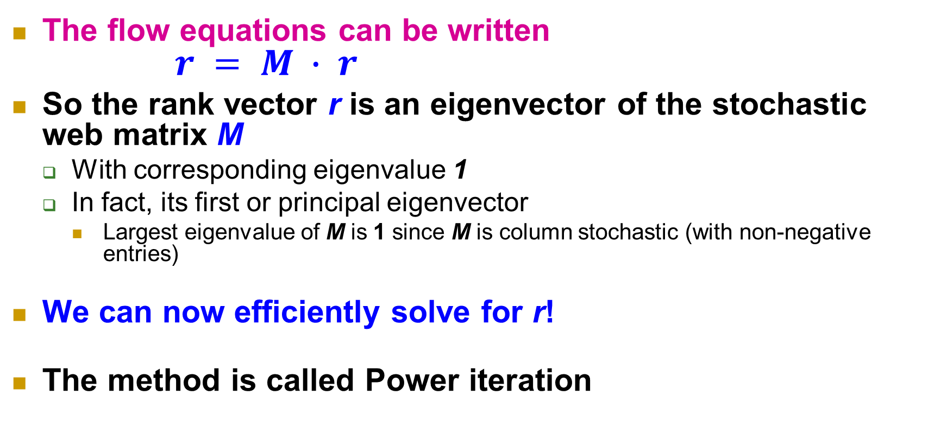
Eigenvalues
The flow equations can be written $r = M ∙ r$
So the rank vector r is an eigenvector of the stochastic web matrix M
With corresponding eigenvalue 1
In fact, its first or principal eigenvector
Largest eigenvalue of M is 1 since M is column stochastic (with non-negative entries)
We can now efficiently solve for r!
The method is called Power iteration

Slide 25
Power Iteration Method
Power iteration: a simple iterative scheme
Suppose there are N web pages
Initialize: r⁽⁰⁾ = [1/N,….,1/N]^{T}
Iterate: r^{(t+1)} = M ∙ r^{(t)}
Stop when |r^{(t+1)} – r^{(t)}|₁ < ε
d_{i} …. out-degree of node i
|x|₁ = ∑_{1≤i≤N}|x_{i}| is the L1 norm
Can use any other vector norm, e.g., Euclidean

Slide 26
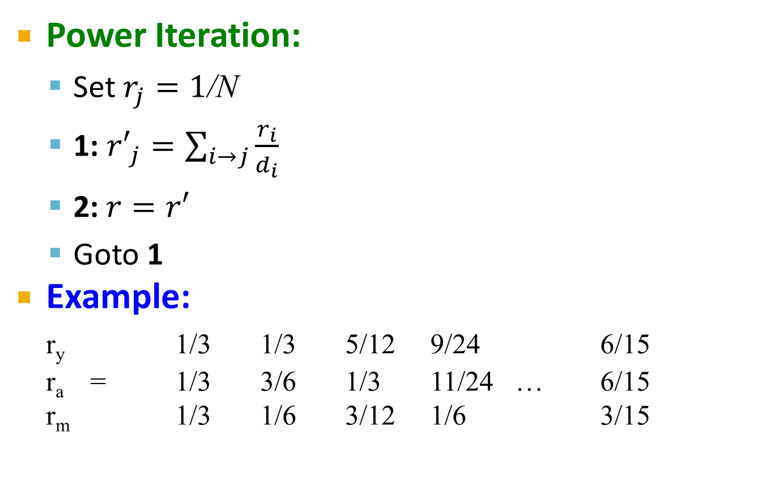
Example
y
 | y | a | m
y | ½ | ½ | 0
a | ½ | 0 | 1
m | 0 | ½ | 0
Power Iteration:
Set $r_{j}=1$/N
1: ${r′}_{j}=\sum_{i→j}{\frac{r_{i}}{d_{i}}}$
2:$r=r′$
Goto 1
Example:
r_{y} 1/3 1/3 5/12 9/24 6/15
r_{a} = 1/3 3/6 1/3 11/24 … 6/15
r_{m} 1/3 1/6 3/12 1/6 3/15
a
m
r_{y} = r_{y} /2 + r_{a} /2
r_{a} = r_{y} /2 + r_{m}
r_{m} = r_{a} /2
Iteration 0, 1, 2, …

Slide 27
Example
y
 | y | a | m
y | ½ | ½ | 0
a | ½ | 0 | 1
m | 0 | ½ | 0
Power Iteration:
Set $r_{j}=1$/N
1: ${r′}_{j}=\sum_{i→j}{\frac{r_{i}}{d_{i}}}$
2:$r=r′$
Goto 1
Example:
r_{y} 1/3 1/3 5/12 9/24 6/15
r_{a} = 1/3 3/6 1/3 11/24 … 6/15
r_{m} 1/3 1/6 3/12 1/6 3/15
a
m
r_{y} = r_{y} /2 + r_{a} /2
r_{a} = r_{y} /2 + r_{m}
r_{m} = r_{a} /2
Iteration 0, 1, 2, …

Slide 28
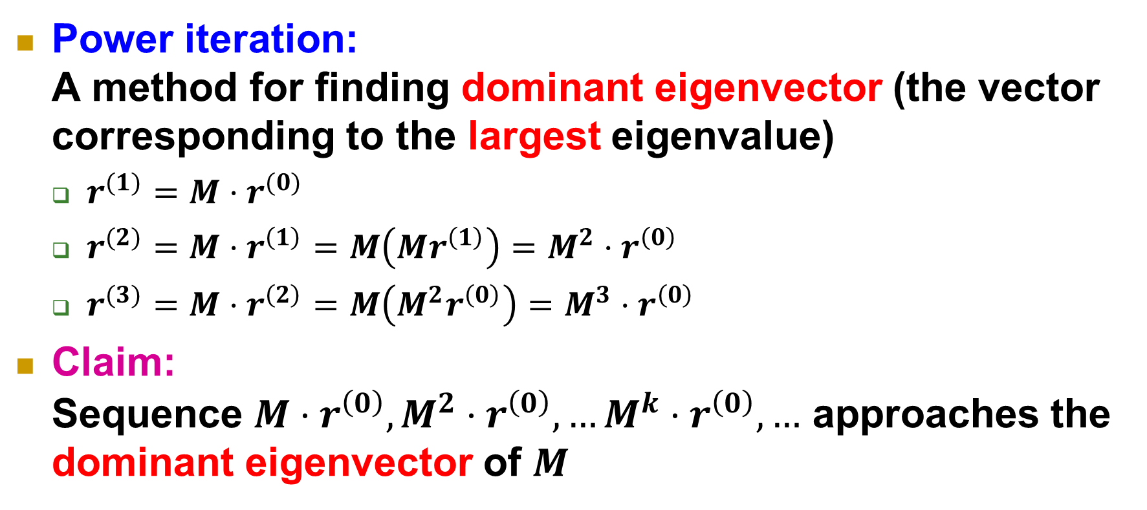
Correctness
Power iteration: A method for finding dominant eigenvector (the vector corresponding to the largest eigenvalue)
$r^{(1)}=M⋅r^{(0)}$
$r^{(2)}=M⋅r^{\left(1\right)}=M\left(Mr^{\left(1\right)}\right)=M^{2}⋅r^{\left(0\right)}$
$r^{(3)}=M⋅r^{\left(2\right)}=M\left(M^{2}r^{\left(0\right)}\right)=M^{3}⋅r^{\left(0\right)}$
Claim: Sequence $M⋅r^{\left(0\right)},M^{2}⋅r^{\left(0\right)},…M^{k}⋅r^{\left(0\right)},…$ approaches the dominant eigenvector of $M$

Slide 29
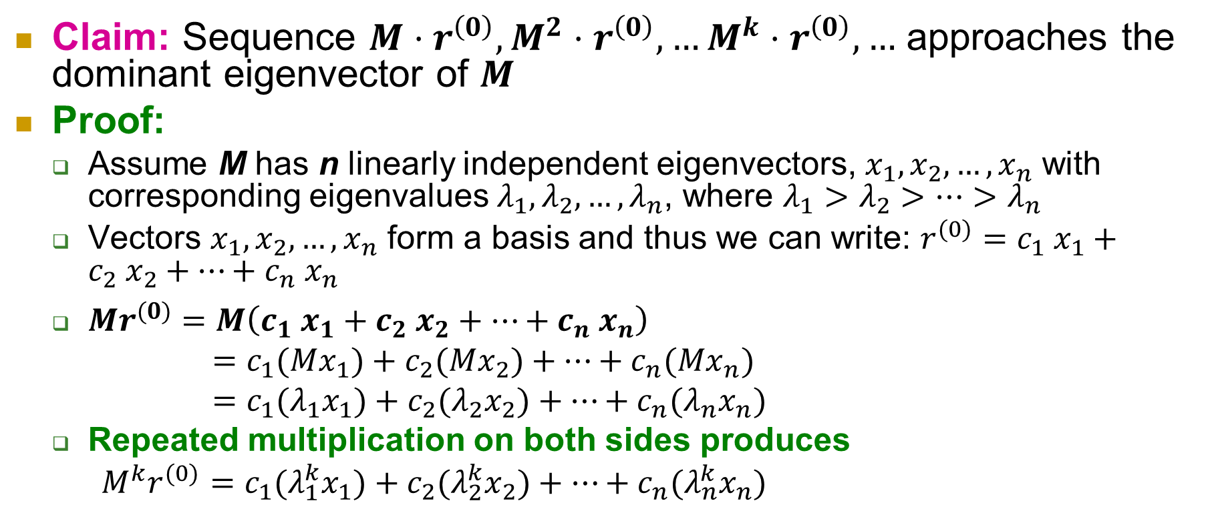
Correctness
Claim: Sequence $M⋅r^{\left(0\right)},M^{2}⋅r^{\left(0\right)},…M^{k}⋅r^{\left(0\right)},…$ approaches the dominant eigenvector of $M$
Proof:
Assume M has n linearly independent eigenvectors, $x_{1}, x_{2}, …, x_{n}$ with corresponding eigenvalues $λ_{1},λ_{2}, …,λ_{n}$, where $λ_{1}>λ_{2}>…>λ_{n}$
Vectors $x_{1}, x_{2}, …, x_{n}$ form a basis and thus we can write: ${r^{(0)}=c_{1} x}_{1}+c_{2} x_{2}+…+c_{n} x_{n}$
$Mr^{(0)}=M\left(c_{1} x_{1}+c_{2} x_{2}+…+c_{n} x_{n}\right)$
$=c_{1}(Mx_{1})+c_{2}(Mx_{2})+…+c_{n}(Mx_{n})$
$=c_{1}(λ_{1}x_{1})+c_{2}(λ_{2}x_{2})+…+c_{n}(λ_{n}x_{n})$
Repeated multiplication on both sides produces
$M^{k}r^{(0)}=c_{1}(λ_{1}^{k}x_{1})+c_{2}(λ_{2}^{k}x_{2})+…+c_{n}(λ_{n}^{k}x_{n})$

Slide 30
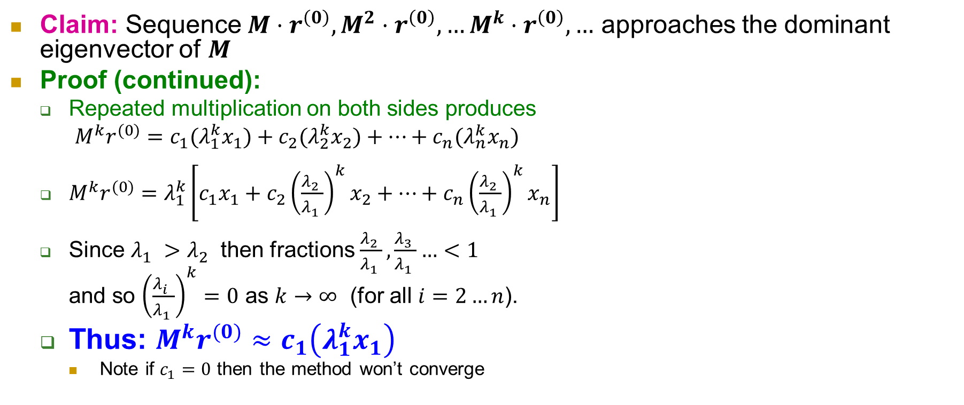
Correctness
Claim: Sequence $M⋅r^{\left(0\right)},M^{2}⋅r^{\left(0\right)},…M^{k}⋅r^{\left(0\right)},…$ approaches the dominant eigenvector of $M$
Proof (continued):
Repeated multiplication on both sides produces
$M^{k}r^{(0)}=c_{1}(λ_{1}^{k}x_{1})+c_{2}(λ_{2}^{k}x_{2})+…+c_{n}(λ_{n}^{k}x_{n})$
$M^{k}r^{(0)}=λ_{1}^{k}\left[c_{1}x_{1}+c_{2}{\left(\frac{λ_{2}^{}}{λ_{1}^{}}\right)}^{k}x_{2}+…+c_{n}{\left(\frac{λ_{2}^{}}{λ_{1}^{}}\right)}^{k}x_{n}\right]$
Since $λ_{1}^{}>λ_{2}^{}$ then fractions $\frac{λ_{2}^{}}{λ_{1}^{}},\frac{λ_{3}^{}}{λ_{1}^{}}…<1$ and so ${\left(\frac{λ_{i}^{}}{λ_{1}^{}}\right)}^{k}=0$ as $k→∞$ (for all $i=2…n$).
Thus: $M^{k}r^{(0)}≈c_{1}\left(λ_{1}^{k}x_{1}\right)$
Note if $c_{1}=0$ then the method won’t converge

Slide 31
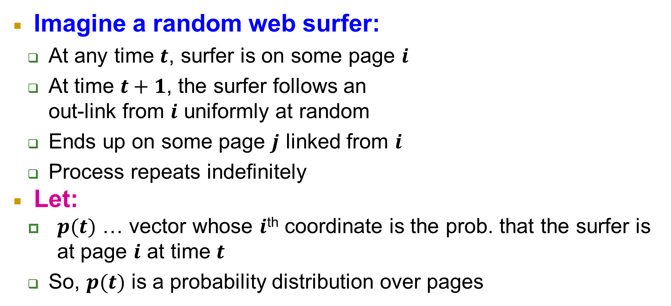
Perspective of Random Walk
i₁
i₂
i₃
Imagine a random web surfer:
At any time $t$, surfer is on some page $i$
At time $t+1$, the surfer follows an out-link from $i$ uniformly at random
Ends up on some page $j$ linked from $i$
Process repeats indefinitely
Let:
$p(t)$ … vector whose $i$^{th} coordinate is the prob. that the surfer is at page $i$ at time $t$
So, $p(t)$ is a probability distribution over pages
j

Slide 32
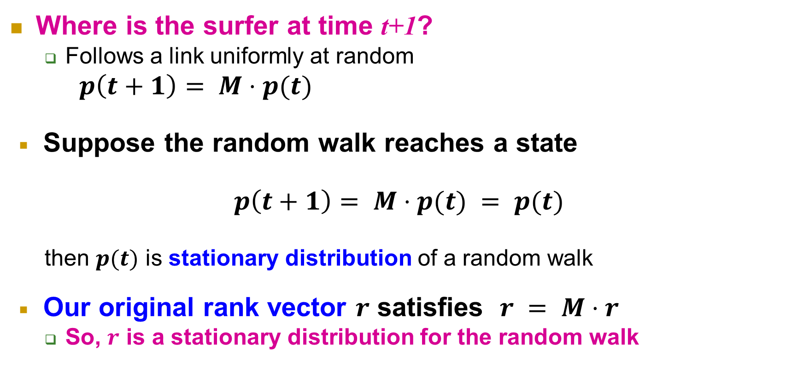
Perspective of Random Walk
i₁
i₂
i₃
Where is the surfer at time t+1?
Follows a link uniformly at random
$p\left(t+1\right)= M⋅p(t)$
Suppose the random walk reaches a state
$$p\left(t+1\right)= M⋅p(t) = p(t)$$
then $p(t)$ is stationary distribution of a random walk
Our original rank vector $r$ satisfies $r = M⋅r$
So, $r$ is a stationary distribution for the random walk
j

Slide 33
Theorem about Stationary Distribution
Existence and Uniqueness
A central result from the theory of random walks (a.k.a. Markov processes):
For graphs that satisfy certain conditions, the stationary distribution is unique and eventually will be reached no matter what the initial probability distribution at time t = 0

Slide 34
Outline
Real-World Graphs
Social graph
…
Web graph
Page Rank
Basic concepts
Google’s Page Rank

Slide 35
Three Questions on Page Rank
Does this converge?
Does it converge to what we want?
Are results reasonable?
or
equivalently

Slide 36
Does This Converge?
Example:
r_{a} 1 0 1 0
r_{b} 0 1 0 1
a
b
=
Iteration 0, 1, 2, …

Slide 37
Does it converge to what we want?
Example:
r_{a} 1 0 0 0
r_{b} 0 1 0 0
a
b
=
Iteration 0, 1, 2, …

Slide 38
Problems in Practical Web Graphs
2 problems:
(1) Some pages are dead ends
(have no out-links)
Random walk has “nowhere” to go to
Such pages cause importance to “leak out”
(2) Spider traps:
(all out-links are within the group)
Random walked gets “stuck” in a trap
And eventually spider traps absorb all importance
Dead end
Spider trap

Slide 39
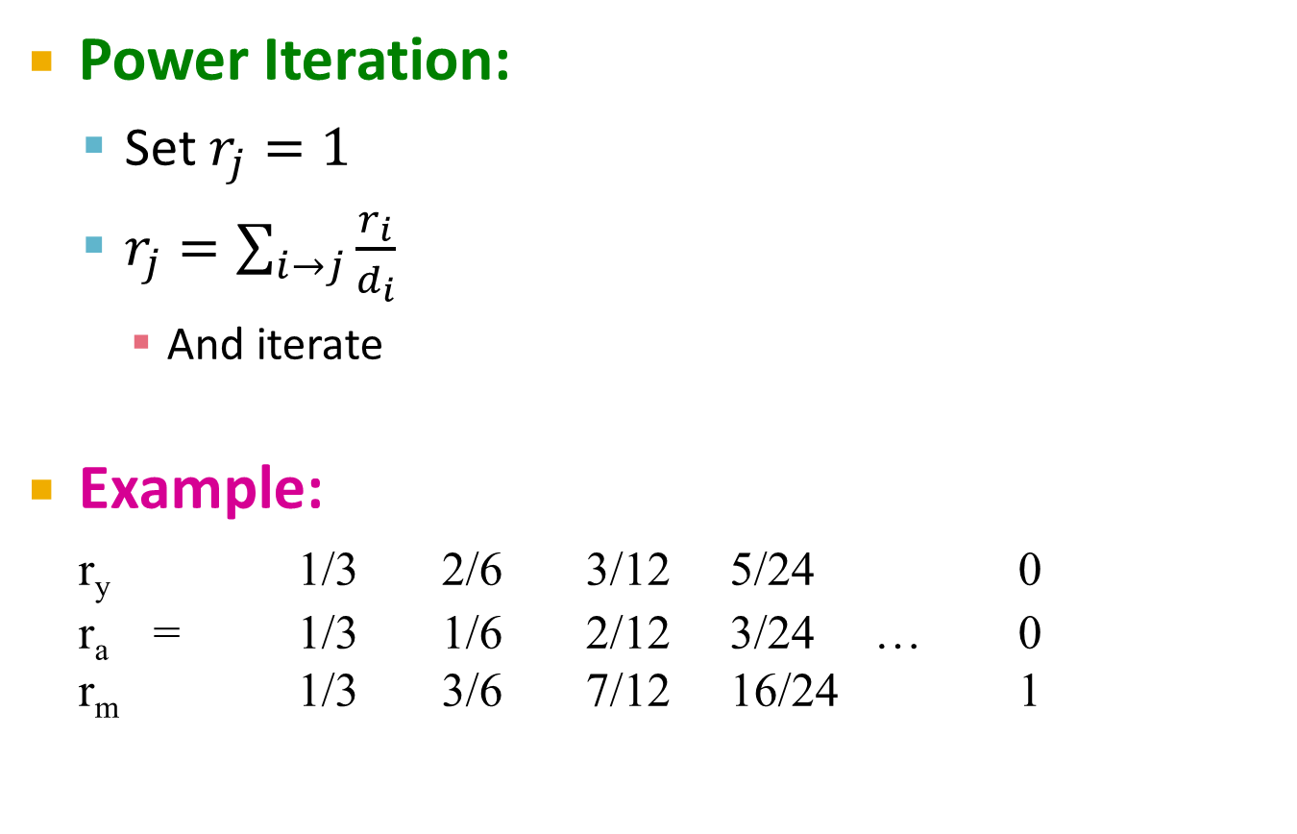
Problem: Spider Traps
Power Iteration:
Set $r_{j}=1$
$r_{j}=\sum_{i→j}{\frac{r_{i}}{d_{i}}}$
And iterate
Example:
r_{y} 1/3 2/6 3/12 5/24 0
r_{a} = 1/3 1/6 2/12 3/24 … 0
r_{m} 1/3 3/6 7/12 16/24 1
y
 | y | a | m
y | ½ | ½ | 0
a | ½ | 0 | 0
m | 0 | ½ | 1
a
m
m is a spider trap
r_{y} = r_{y} /2 + r_{a} /2
r_{a} = r_{y} /2
r_{m} = r_{a} /2 + r_{m}
Iteration 0, 1, 2, …

Slide 40
Solution: Teleports
The Google solution for spider traps: At each time step, the random surfer has two options
With prob. β, follow a link at random
With prob. 1-β, jump to some random page
Common values for β are in the range 0.8 to 0.9
Surfer will teleport out of spider trap within a few time steps
y
y
a
m
a
m

Slide 41
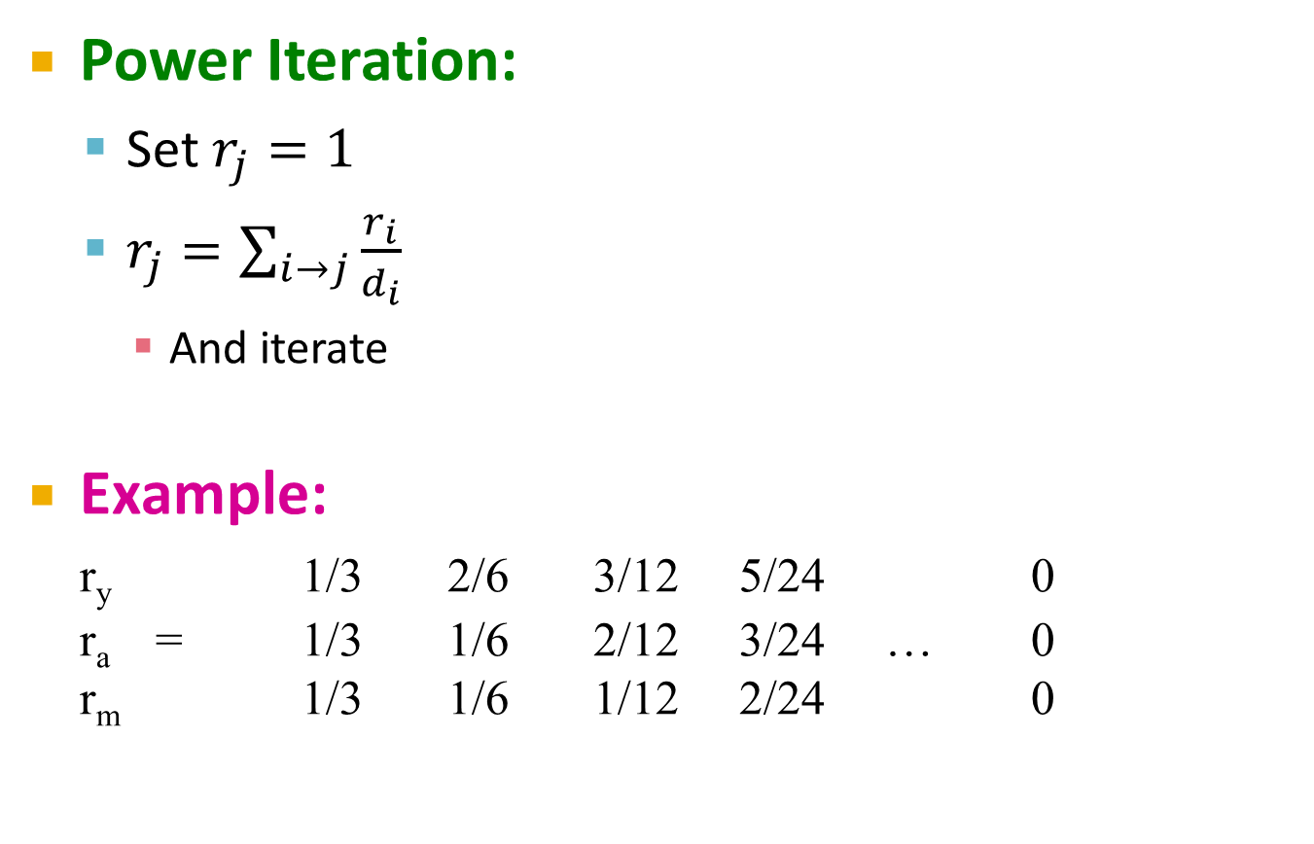
Problem: Dead Ends
Power Iteration:
Set $r_{j}=1$
$r_{j}=\sum_{i→j}{\frac{r_{i}}{d_{i}}}$
And iterate
Example:
r_{y} 1/3 2/6 3/12 5/24 0
r_{a} = 1/3 1/6 2/12 3/24 … 0
r_{m} 1/3 1/6 1/12 2/24 0
y
 | y | a | m
y | ½ | ½ | 0
a | ½ | 0 | 0
m | 0 | ½ | 0
a
m
r_{y} = r_{y} /2 + r_{a} /2
r_{a} = r_{y} /2
r_{m} = r_{a} /2
Iteration 0, 1, 2, …

Slide 42
Solution: Always Teleports
Teleports: Follow random teleport links with probability 1.0 from dead-ends
Adjust matrix accordingly
y
y
a
m
a
m
 | y | a | m
y | ½ | ½ | 0
a | ½ | 0 | 0
m | 0 | ½ | 0
 | y | a | m
y | ½ | ½ | ⅓
a | ½ | 0 | ⅓
m | 0 | ½ | ⅓

Slide 43
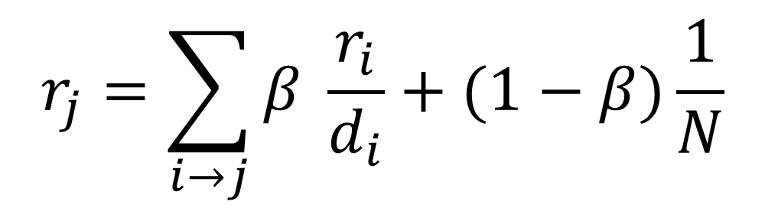
Putting It Together
Google’s solution that does it all: At each step, random surfer has two options:
With probability β, follow a link at random
With probability 1-β, jump to some random page
PageRank equation [Brin-Page, 98]
$$r_{j}=\sum_{i→j}{β \frac{r_{i}}{d_{i}}}+(1−β)\frac{1}{N}$$
d_{i} … out-degree of node i
This formulation assumes that $M$ has no dead ends. We can either preprocess matrix $M$ to remove all dead ends or explicitly follow random teleport links with probability 1.0 from dead-ends.

Slide 44
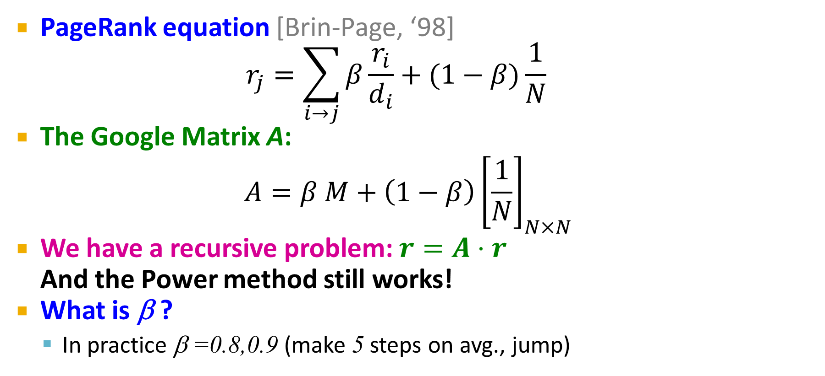
The Google Matrix
PageRank equation [Brin-Page, ‘98] $r_{j}=\sum_{i→j}{β\frac{r_{i}}{d_{i}}}+(1−β)\frac{1}{N}$
The Google Matrix A:
$$A=β M+\left(1−β\right){\left[\frac{1}{N}\right]}_{N×N}$$
We have a recursive problem: $r=A⋅r$ And the Power method still works!
What is β ?
In practice β =0.8,0.9 (make 5 steps on avg., jump)
[1/N]_{NxN}…N by N matrix where all entries are 1/N

Slide 45
Example
M
[1/N]_{NxN}
7/15
y
1/2 1/2 0
1/2 0 0
0 1/2 1
1/3 1/3 1/3
1/3 1/3 1/3
1/3 1/3 1/3
0.8
+ 0.2
7/15
1/15
7/15
1/15
y 7/15 7/15 1/15
a 7/15 1/15 1/15
m 1/15 7/15 13/15
13/15
a
7/15
m
1/15
1/15
A
y
a =
m
1/3
1/3
1/3
0.33
0.20
0.46
0.24
0.20
0.52
0.26
0.18
0.56
7/33
5/33
21/33
. . .

Slide 46
Outline
Real-World Graphs
Social graph
…
Web graph
Page Rank
Basic concepts
Google’s Page Rank
Spectral Graph Theory

Slide 47
Spectral Graph Theory
Represent graphs by matrices
Apply knowledge from Linear Algebra
Typical matrix: adjacent matrix, Laplacian matrix
Typical matrix property: spectrum
The sorted eigenvalues of a matrix
Sorted by magnitude (strength)
Wikipedia: The study of the properties of a graph in relationship to the characteristic polynomial, eigenvalues, and eigenvectors of matrices associated with the graph, such as its adjacency matrix or Laplacian matrix
Spectral graph theory - Wikipedia

Slide 48
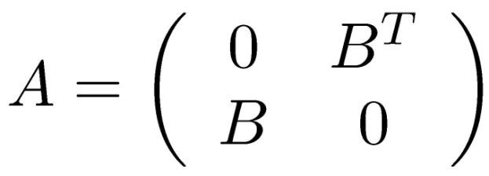
Bipartite Graphs
Any graph with no cycles of odd length is bipartite
e.g., all trees are bipartite
K_{3,3}
1
4
2
5
Can we check if a graph is bipartite via its spectrum? Can we get the partition of the vertices in the two sets of nodes?
3
6

Slide 49

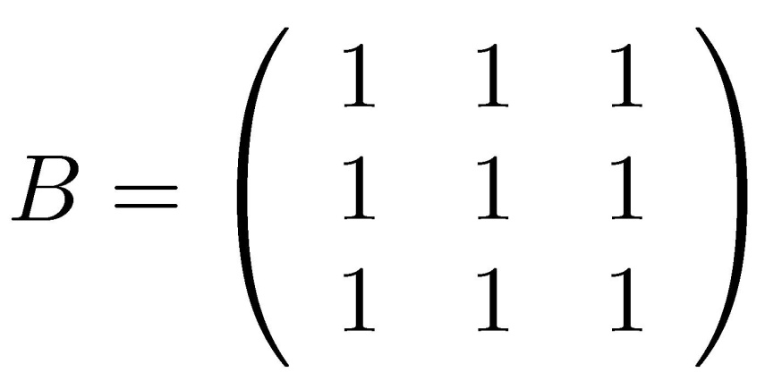
Bipartite Graphs
Adjacency matrix
K_{3,3}
1
4
where
2
5
3
6
Why λ₁=-λ₂=3? Recall: Ax=λx, (λ,x) eigenvalue-eigenvector
Eigenvalues:
Λ=[3,-3,0,0,0,0]

Slide 50
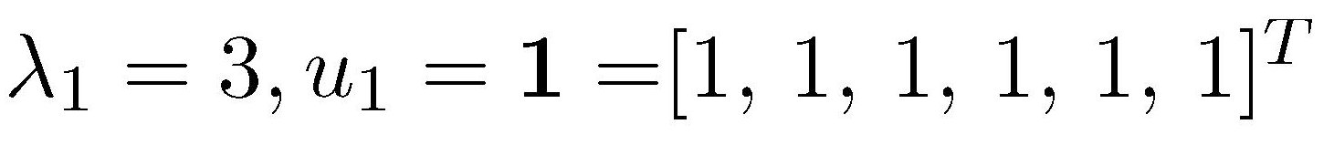
Bipartite Graphs
3=3x1
1
2
1
1
3
1
1
4
1
4
1
1
1
2
5
5
1
1
1
3
6
6
Repeat same argument for the other nodes

Slide 51
Bipartite Graphs
-1
-3=(-3)x1
-1
-2
1
-3
-1
1
4
1
4
1
-1
-1
2
5
5
1
-1
-1
3
6
6
Repeat same argument for the other nodes

Slide 52
Bipartite Graphs
Observation u₂ gives the partition of the nodes in the two sets S, V-S!
S
V-S
Question: Were we just “lucky”?
Answer: No
Theorem: λ₂=-λ₁ iff G bipartite. u₂ gives the partition.

Slide 53


Walks
A walk of length r in a directed graph: where a node can be used more than once.
Closed walk when:
4
4
1
1
Closed walk of length 3
2-1-3-2
Walk of length 2
2-1-4
2
2
3
3

Slide 54
Walks
Theorem G(V,E) directed graph, adjacency matrix A. The number of walks from node u to node v in G with length r is (A^{r})_{uv}
Proof
Induction on k
(i,j)
(i, i₁),(i₁,j)
(i,i₁),..,(i_{r-1},j)

Slide 55
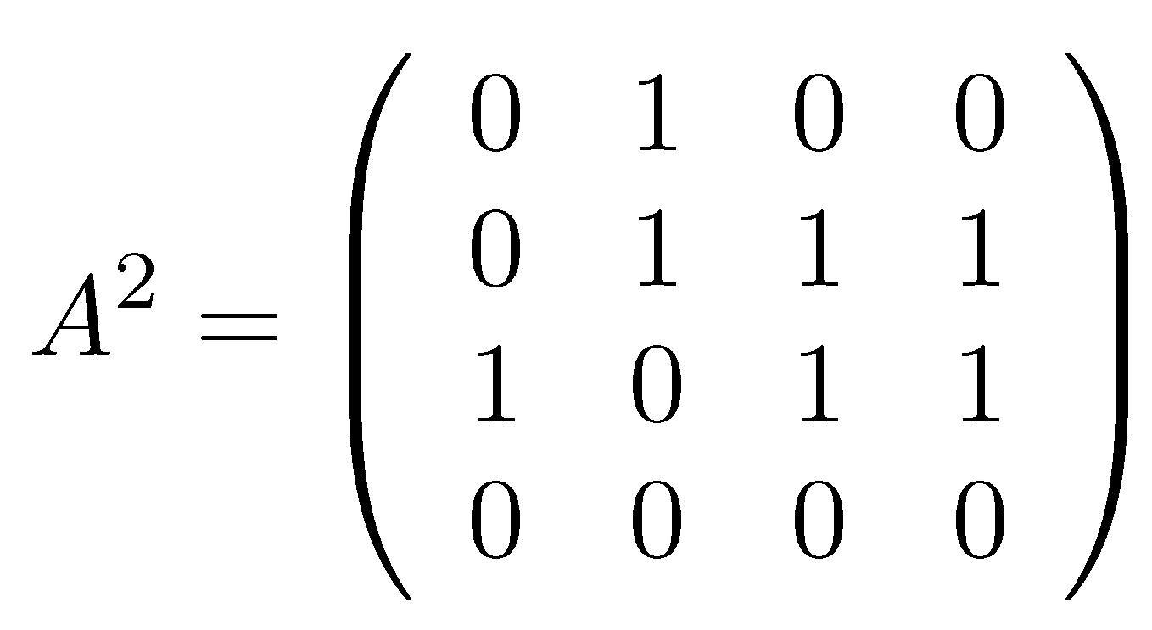
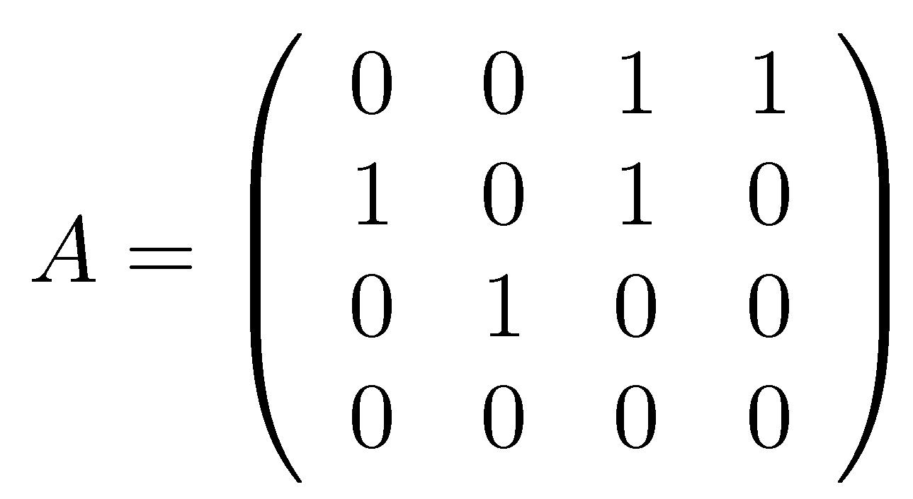
Walks
4
1
2
3
i=2, j=4
4
i=3, j=3
4
1
1
2
3
2
3

Slide 56
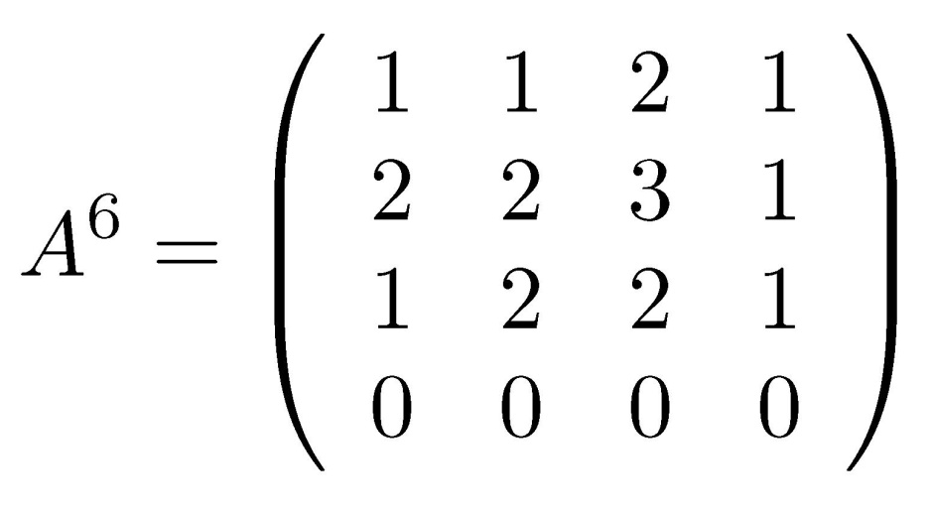
Walks
4
1
2
3
Always 0, node 4 is a sink
4
1
2
3

Slide 57
Walks
Corollary
A adjacency matrix of undirected G(V,E) (no self loops), e edges and t triangles. Then the following hold: a) trace(A) = 0 b) trace(A²) = 2e c) trace(A³) = 6t
1
Computing A^{r} is a bad idea:
High memory requirements, expensive!
1
2
1
2
3

Slide 58
Theorem [EigenTriangle]
Theorem
δ(G) = # triangles in graph G(V,E)
= eigenvalues of adjacency matrix A

Slide 59
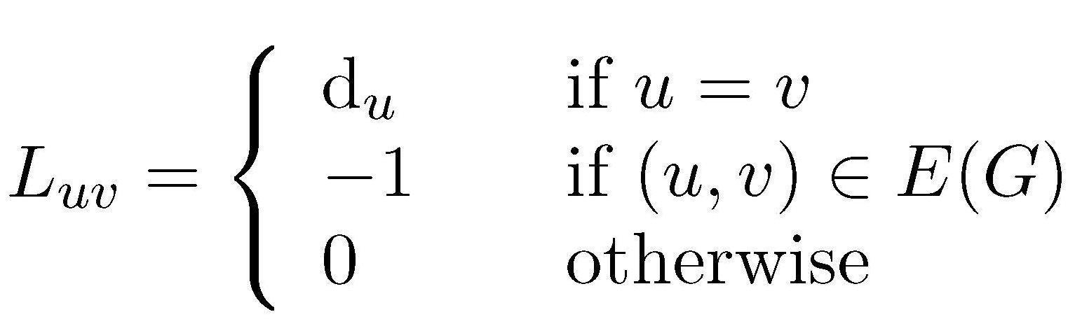
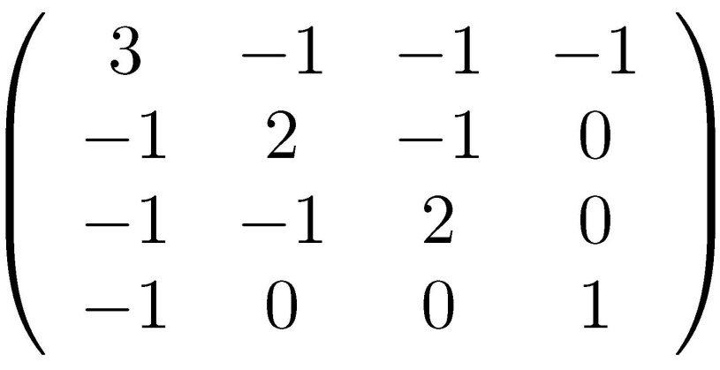
Laplacian
4
1
L= D-A=
2
3
Diagonal matrix, d_{ii}=d_{i}

Slide 60
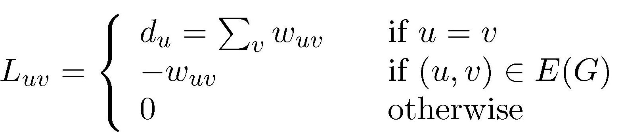
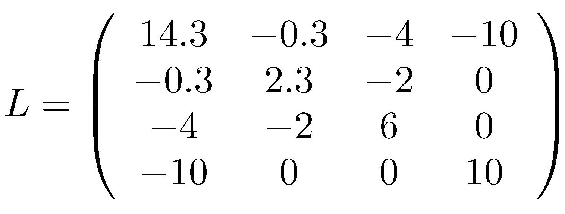
Weighted Laplacian
10
4
1
0.3
4
2
3
2

Slide 61
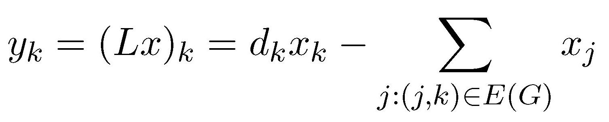
Adjacency vs. Laplacian Intuition
Let x be an indicator vector:
V-S
S
Consider now y=Lx
k-th coordinate

Slide 62
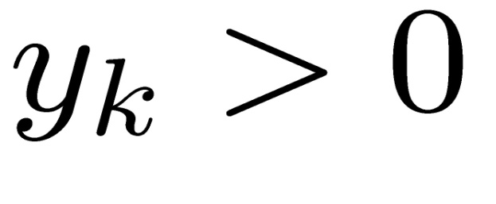
Adjacency vs. Laplacian Intuition
G_{30,0.5}
S
Consider now y=Lx
k

Slide 63
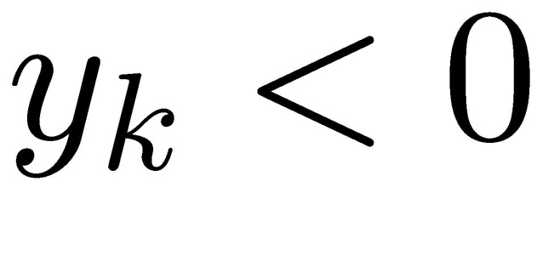
Adjacency vs. Laplacian Intuition
G_{30,0.5}
S
Consider now y=Lx
k

Slide 64
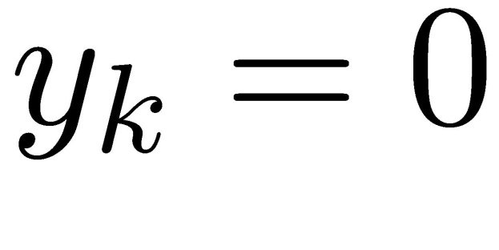
Adjacency vs. Laplacian Intuition
G_{30,0.5}
S
Consider now y=Lx
k
k
Laplacian: connectivity, Adjacency: #paths

Slide 65
Connected Components
Lemma Let G be a graph with n vertices and c connected components. If L is the Laplacian of G, then rank(L)=n-c.
Proof see p.279, Algebraic Graph Theory, Godsil-Royle

Slide 66
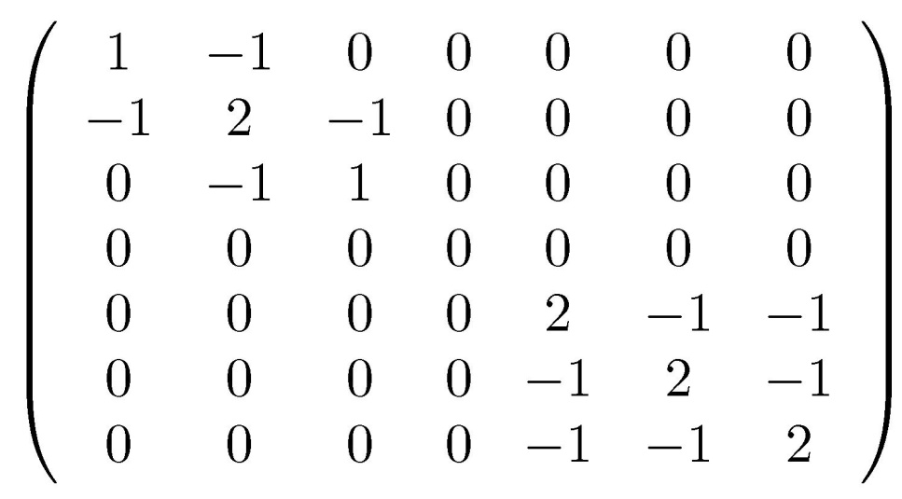
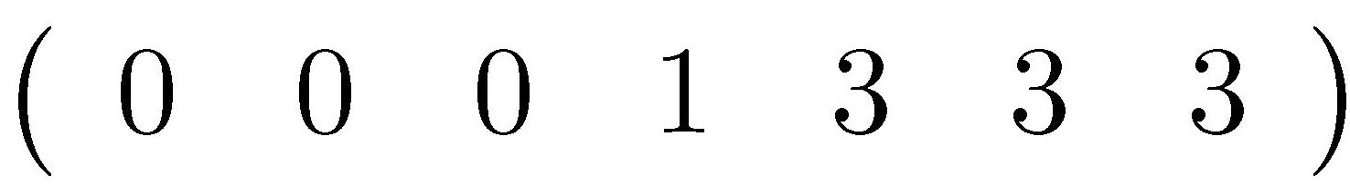
Connected Components
G(V,E)
1
2
3
L=
4
6
#zeros = #components
7
5
eig(L)=

Slide 67
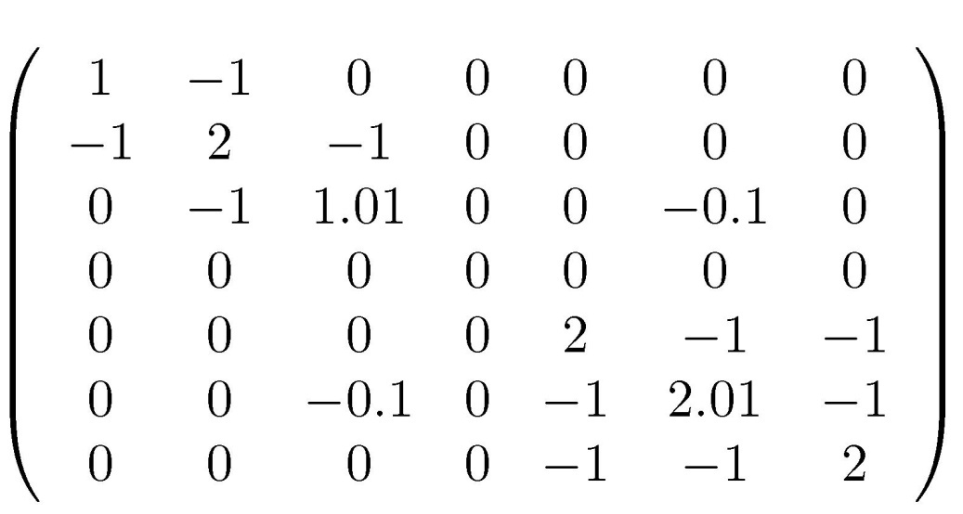
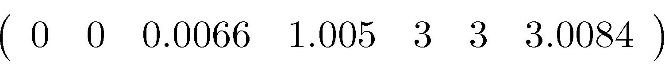
Connected Components
G(V,E)
1
2
3
L=
0.01
4
6
#zeros = #components
Indicates a “good cut”
7
5
eig(L)=

Slide 68
Summary
Real-World Graphs
Social graph
…
Web graph
Page Rank
Basic concepts
Google’s Page Rank
Spectral Graph Theory
Adjacent graph and Laplacian graph
Applications

